Slide 1
Lab 9 : Neural Nets Lab 10 : Relu, Weight Initialization Dropout, Batch Normalization
January 8, 2019
Jeyeon Lee
Dept. of Software
Dankook University
2reenact@naver.com

Slide 2
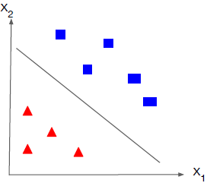
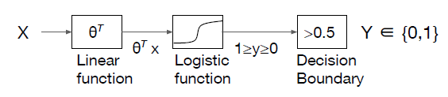
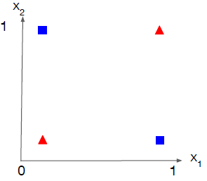
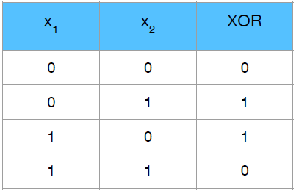
Logistic Regression
Recap
in XOR problem

Slide 3
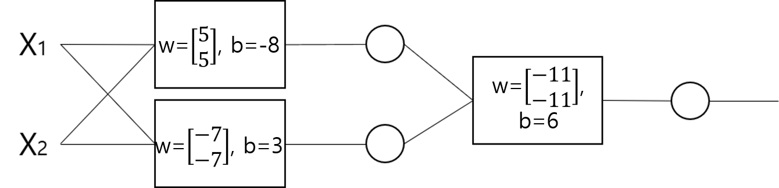
Neural Net
2 layer
X1 | X2 | Y1 | Y2 | Y | XOR
0 | 0 | 0 | 1 | 0 | 0
0 | 1 | 0 | 0 | 1 | 1
1 | 0 | 0 | 0 | 1 | 1
1 | 1 | 1 | 0 | 0 | 0

Slide 4
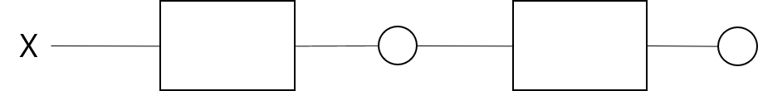
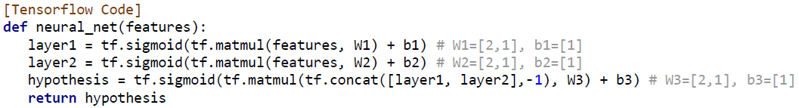
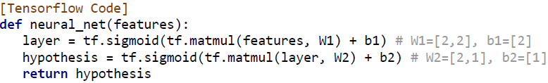
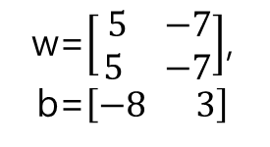
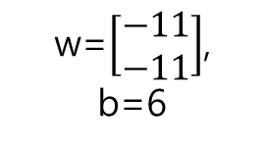
Neural Net
Vector
w=$\left[\begin{matrix} 5 & −7 \\ 5 & −7\end{matrix}\right]$, b=$\left[−8 3\right]$
w=$\left[\begin{aligned}−11 \\ −11\end{aligned}\right]$, b=6

Slide 5

Problem of Sigmoid
Network
Input
Output
ground-truth – output = loss
Backpropagation
d(loss) = gradient
Vanishing Gradient

Slide 6
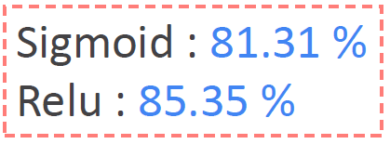
Relu (Rectified Linear Unit)
f(x) = max(0, x)
other activation function
tf.keras.activations – sigmoid, tanh, relu, elu, selu
tf.keras.layers – leaky relu
0

Slide 7
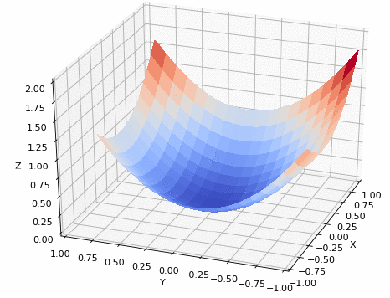
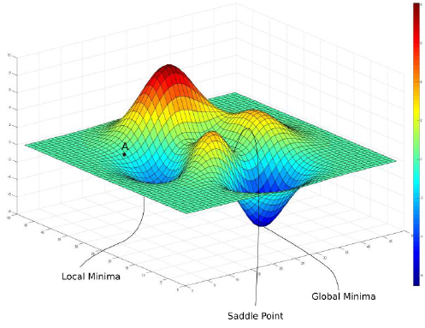
Weight Initialization
Xavier Initialization (glorot initialization)

Slide 8
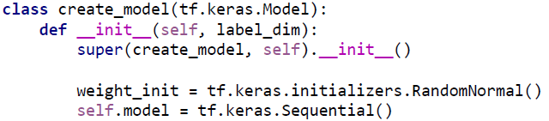
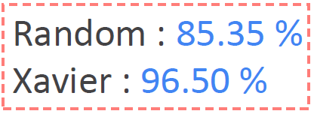

Weight Initialization
Xavier Initialization
$Variance= \frac{2}{Channe_in + Channel_out }$
RandomNormal() ->glorot_uniform()
Relu = He Initialization
RandomNormal() ->he_uniform()

Slide 9
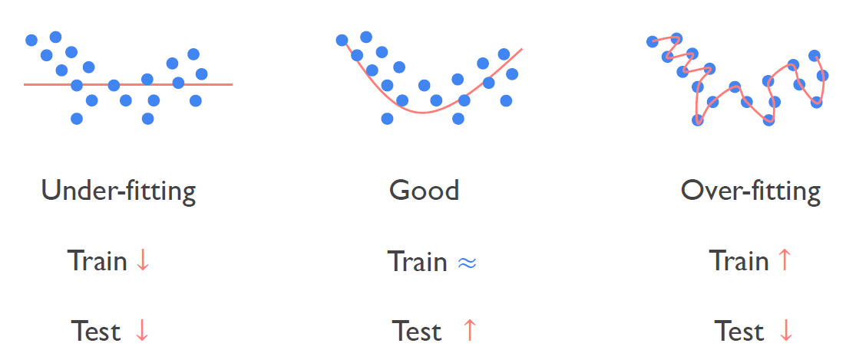
Dropout

Slide 10
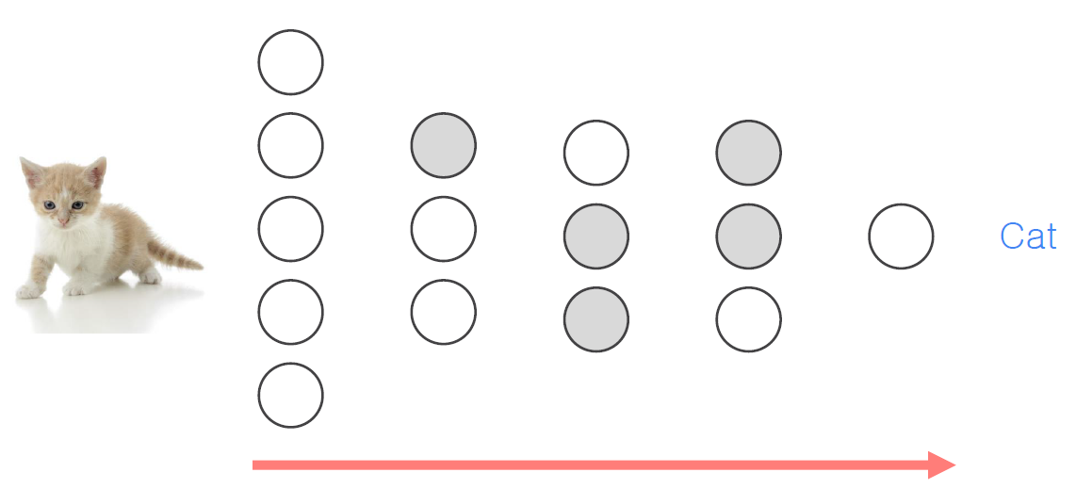
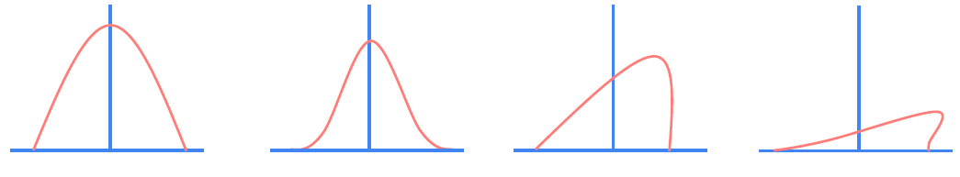
Dropout

Slide 11

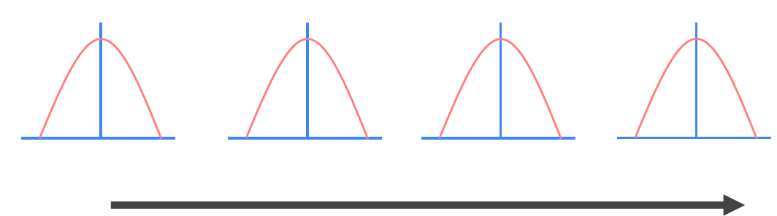
Batch Normalization
Internal Covariate Shift

Slide 12
Summary
XOR problem
Neural Nets
2 layer, vector…
Problem of Sigmoid in Neural Nets
Relu
Weight Initialization
Xavier Initialization
He Initialization
Dropout
Batch Normalization

